Slide 1

Direct Detection of Dark Matter
Name : Chun-Hao Lee (NTHU)
Advisor : Prof. Dr. Chao-Qiang Geng
Chao-Qiang Geng, Da Huang, Chun-Hao Lee, and Qing Wang,
“Direct Detection of Exothermic Dark Matter with a Light Mediator.”,
Journal of Cosmology and Astroparticle Physics 1608, 009 (2016).

Slide 2
Outline
Introduction
General Framework
Results
Conclusion

Slide 3
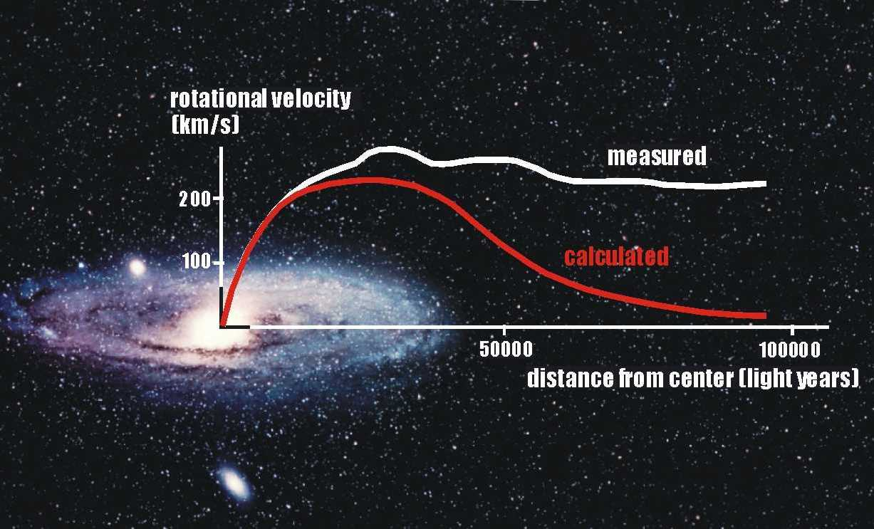
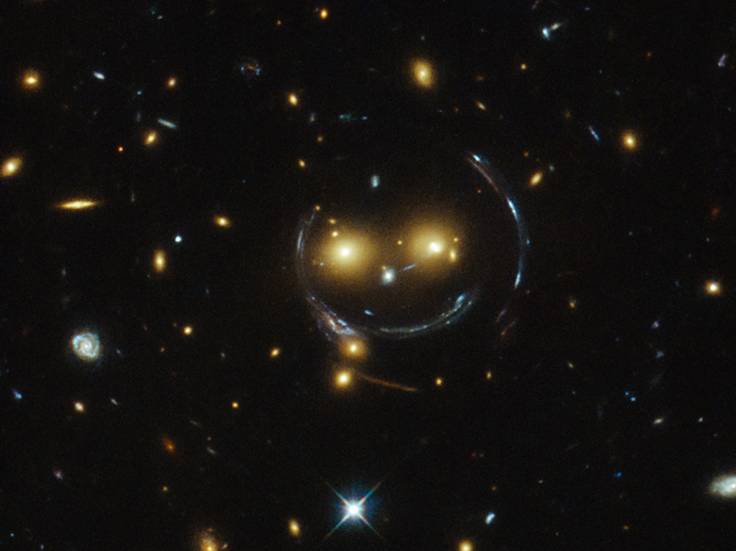
Introduction
Motivation for searching the Dark Matter (DM)
DM: an unseen matter which occupied 27% of the mass and energy in the observable universe
Astronomical and cosmological observations at various scales: Ex.
Rotation curves of spiral galaxies
Gravitational lensing
Angular Cosmic Microwave background (CMB) fluctuations Dark Matter may be the culprit!!!

Slide 4
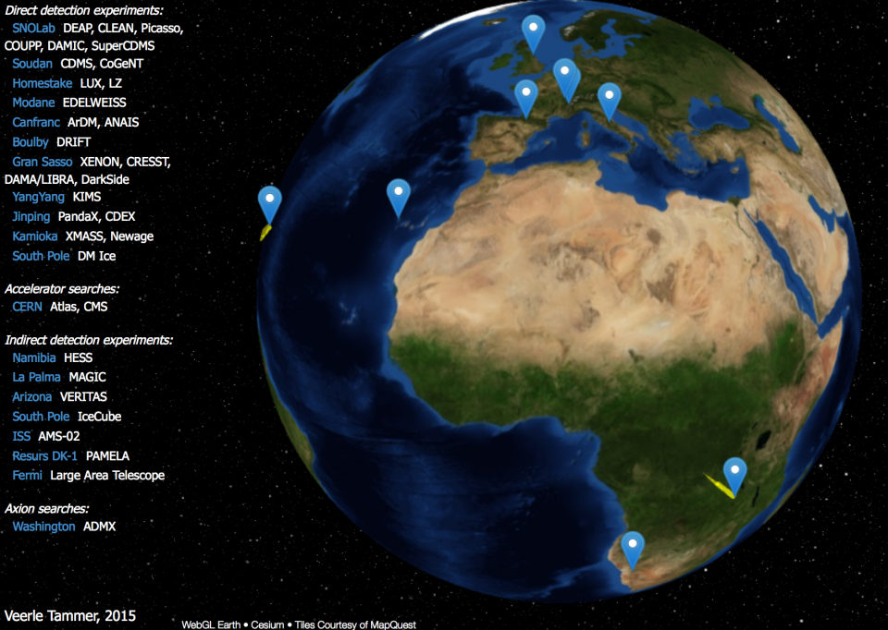
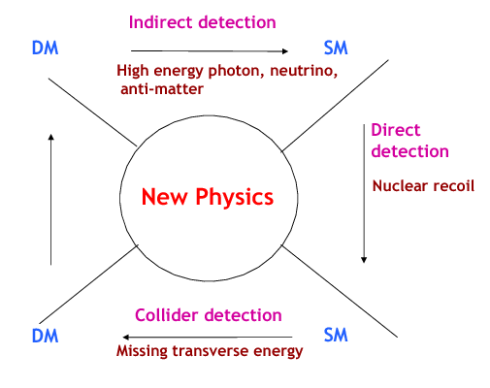
Introduction
Identification of Dark Matter
Dark Matter related experiments around the world
Measure the recoil energy deposited by the interaction of a WIMP particle with a nucleus in the detector

Slide 5
Introduction
Dark Matter Direct Detection experiments
DAMA, CoGeNT, CDMS-Si
CDEX, SuperCDMS, CDMSlite, XENON 10 & 100, LUX (2013, 2015 ),
Positive signals for light WIMPs
Null results
,2016)
PandaX-II

Slide 6
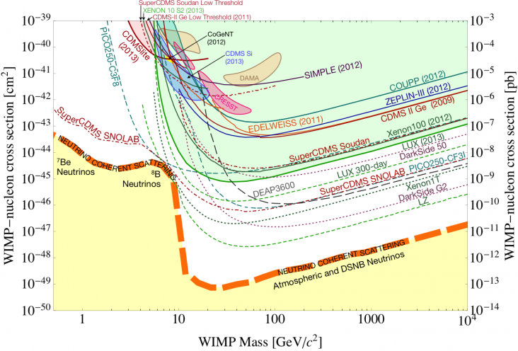
Introduction
Dark Matter Direct Detection experiments
Significant conflict between the signal regions and the exclusion limits
Most of the signal regions had been excluded

Slide 7
General Framework
Previous works:
Exothermic DM
Isospin-violation
Dark matter that can exist in two states with a small mass splitting
Light mediator
The interaction strengths of WIMP particles with proton and neutron are different
W. G. Peter et al., Physics Review D 82, 063512 (2010)
A mediator of the scattering process (dark photon)
J. L. Feng et al., Physics Letters B, 703(2011) 124-127
Dark Matter Models
LUX (2013) & SuperCDMS

Slide 8
General Framework
Motivations for this work:
Combination of two mechanisms after 2013
Elastic DM with Light Mediator and Isospin Violation
Exothermic DM with Isospin Violation
Nan Chen et al., Phys. Lett. B 743, 205 (2015)
L. Tai, M. Sen, and Y. F. Zhou , JCAP 1503 (2015)
Dark Matter Models
LUX (2015) & CDMSlite
LUX (2016) & PandaX-II

Slide 9
General Framework
Motivations for this work:
New combination of three mechanisms
Isospin-conserving Exothermic DM with Light Mediator
Isospin-violating Exothermic DM with light mediator
Dark Matter Models
LUX (2015) & CDMSlite
LUX (2016) & PandaX-II

Slide 10
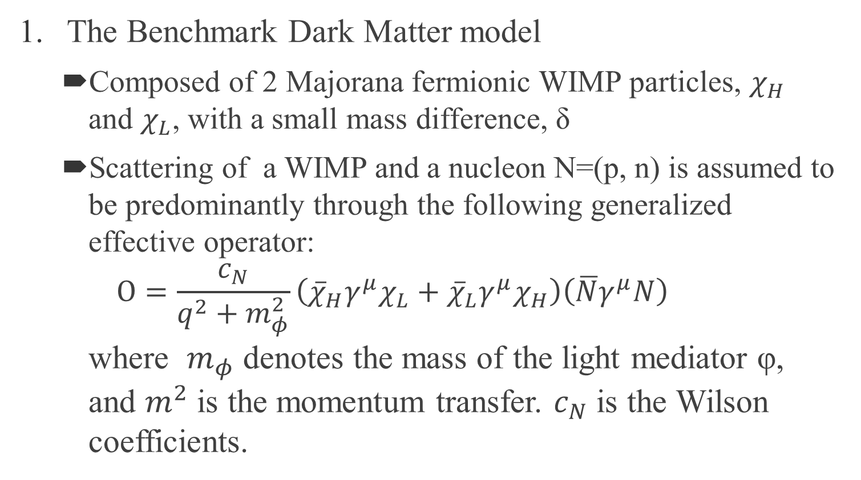
General Framework
The Benchmark Dark Matter model
Composed of 2 Majorana fermionic WIMP particles, $χ_{H}$ and $χ_{L}$, with a small mass difference, δ
Scattering of a WIMP and a nucleon N=(p, n) is assumed to be predominantly through the following generalized effective operator: $Ο=\frac{c_{N}}{q^{2}+m_{φ}^{2}}\left({\overline{χ}}_{H}γ^{μ}χ_{L}+{\overline{χ}}_{L}γ^{μ}χ_{H}\right)\left(\overline{N}γ^{μ}N\right)$ where $m_{φ}$ denotes the mass of the light mediator φ, and $m^{2}$ is the momentum transfer. $c_{N}$ is the Wilson coefficients.

Slide 11
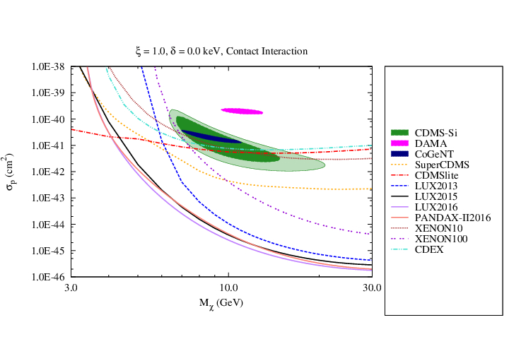
Fitting Results
Conventional Spin-Independent model

Slide 12
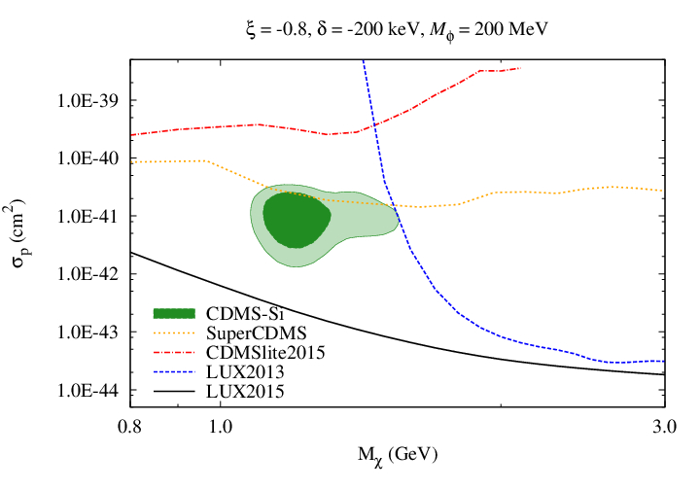
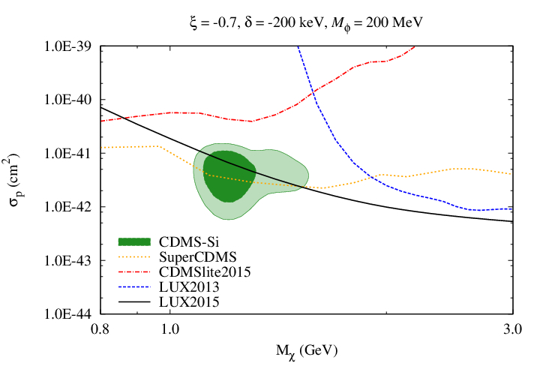
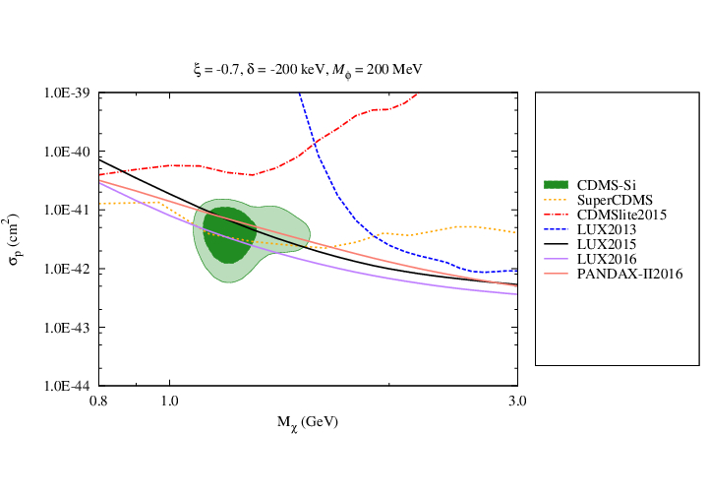
Fitting Results
Exothermic DM with Isospin Violation
Xe-phobic exothermic DM
Ge-phobic exothermic DM

Slide 13
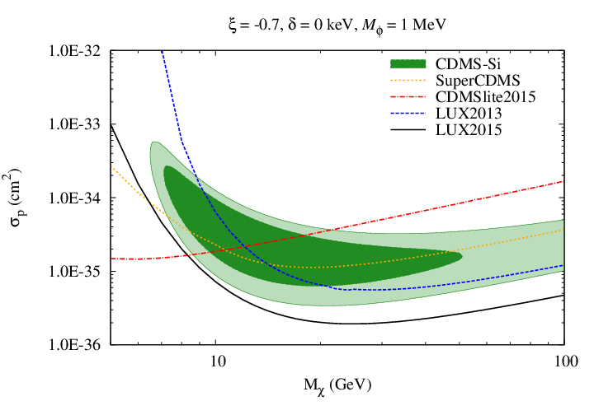
Fitting Results
Xe-phobic elastic DM with Light Mediator

Slide 14
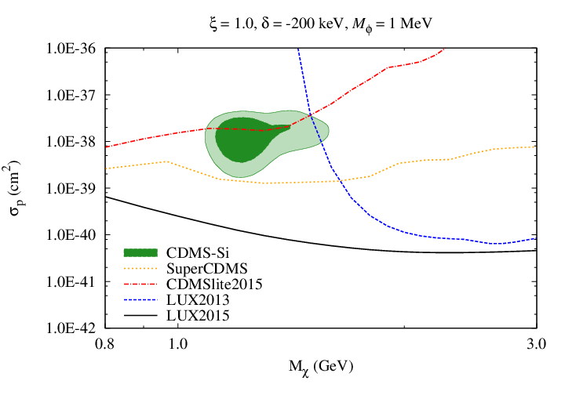
Fitting Results
Isospin-conserving Exothermic DM with a light mediator

Slide 15
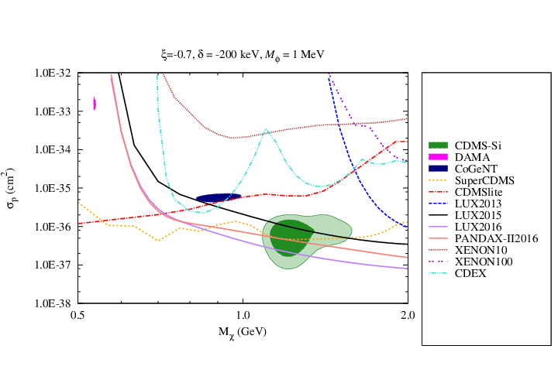
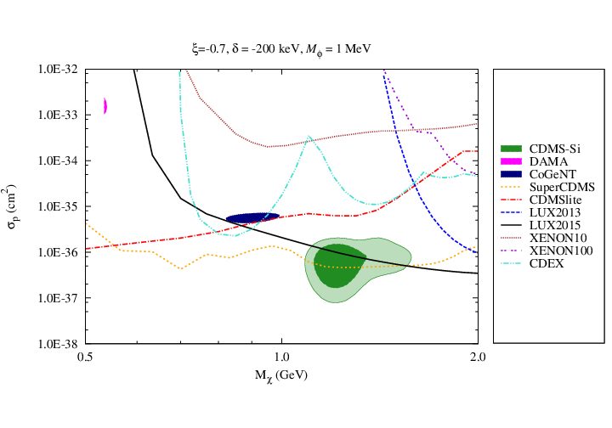
Fitting Results
Isospin-violating Exothermic DM with a light mediator

Slide 16
Conclusions
Considered the direct detections of WIMP particles with the spin-independent interactions
Examined the models which involve different combinations of the three mechanisms below:
Isospin violation
Exothermic scattering
Light mediator
Most of the combinations have been ruled out
Xe-phobic exothermic DM with/without light mediator (Only survivors)
Latest experimental data provide additional challenges to these models

Slide 17
Thank you for your attention…

Slide 18
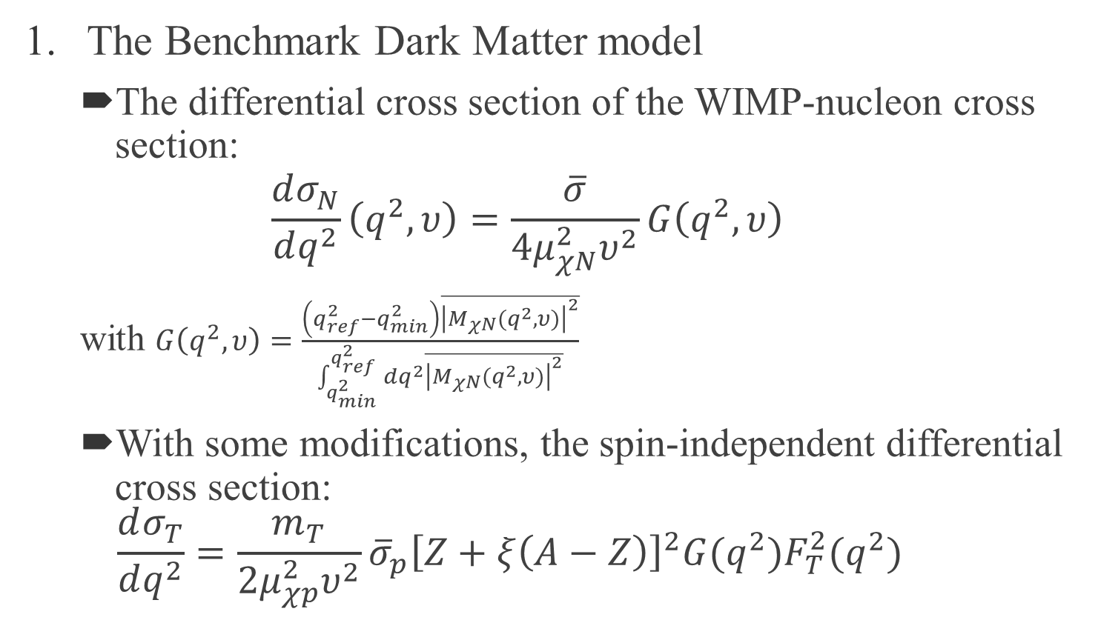
Theoretical Framework
The Benchmark Dark Matter model
The differential cross section of the WIMP-nucleon cross section:
$$\frac{dσ_{N}}{dq^{2}}\left(q^{2},υ\right)=\frac{\overline{σ}}{4μ_{χN}^{2}υ^{2}}G\left(q^{2},υ\right)$$ with $G\left(q^{2},υ\right)=\frac{\left(q_{ref}^{2}−q_{min}^{2}\right)\overline{{\left|M_{χN}(q^{2},υ)\right|}^{2}}}{\int_{q_{min}^{2}}^{q_{ref}^{2}}{dq^{2}\overline{{\left|M_{χN}(q^{2},υ)\right|}^{2}}}}$
With some modifications, the spin-independent differential cross section: $\frac{dσ_{T}}{dq^{2}}=\frac{m_{T}}{2μ_{χp}^{2}υ^{2}}{\overline{σ}}_{p}{\left[Z+ξ\left(A−Z\right)\right]}^{2}G(q^{2})F_{T}^{2}(q^{2})$

Slide 19
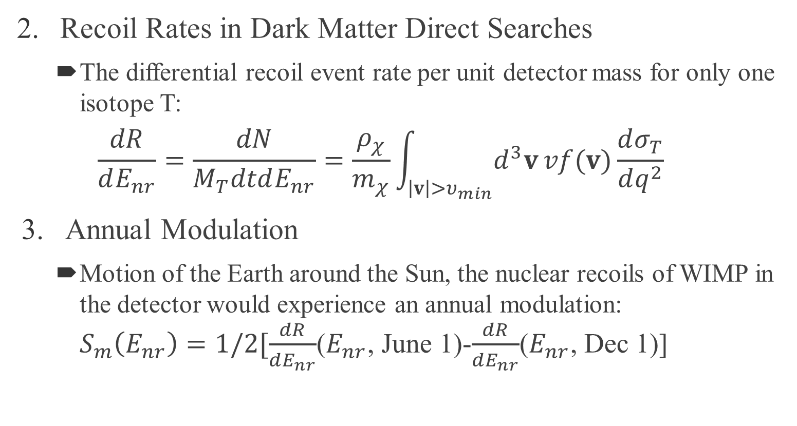
Theoretical Framework
Recoil Rates in Dark Matter Direct Searches
The differential recoil event rate per unit detector mass for only one isotope T:
$$\frac{dR}{dE_{nr}}=\frac{dN}{M_{T}dtdE_{nr}}=\frac{ρ_{χ}}{m_{χ}}\int_{\left|v\right|>υ_{min}}{d^{3}v}vf(v)\frac{dσ_{T}}{dq^{2}}$$
Annual Modulation
Motion of the Earth around the Sun, the nuclear recoils of WIMP in the detector would experience an annual modulation: $S_{m}\left(E_{nr}\right)=1/2[\frac{dR}{dE_{nr}}$($E_{nr}$, June 1)-$\frac{dR}{dE_{nr}}$($E_{nr}$, Dec 1)]

Slide 20
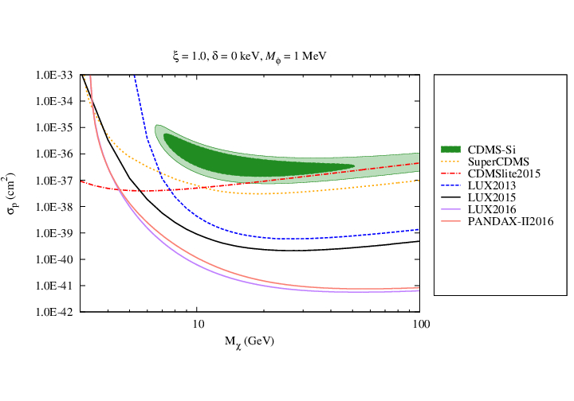
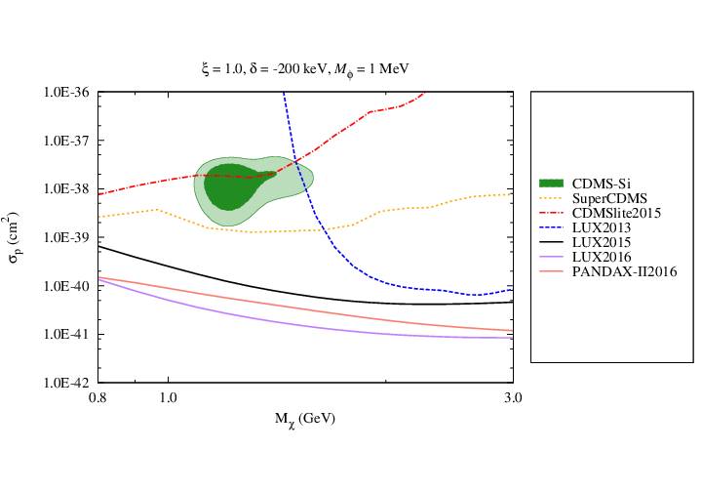
Fitting Results
Exothermic DM with Light Mediator

